Slide 1
A meta-analysis of expert-curated Boolean gene regulatory network models reveals a number of special structural and dynamical features
Claus Kadelka
Department of Mathematics
Iowa State University
Mar 18, 2025

Slide 2
Outline
Introduction: Boolean gene regulatory network models
Features of the wiring diagram
Features of the update rules
Features of the dynamics

Slide 3
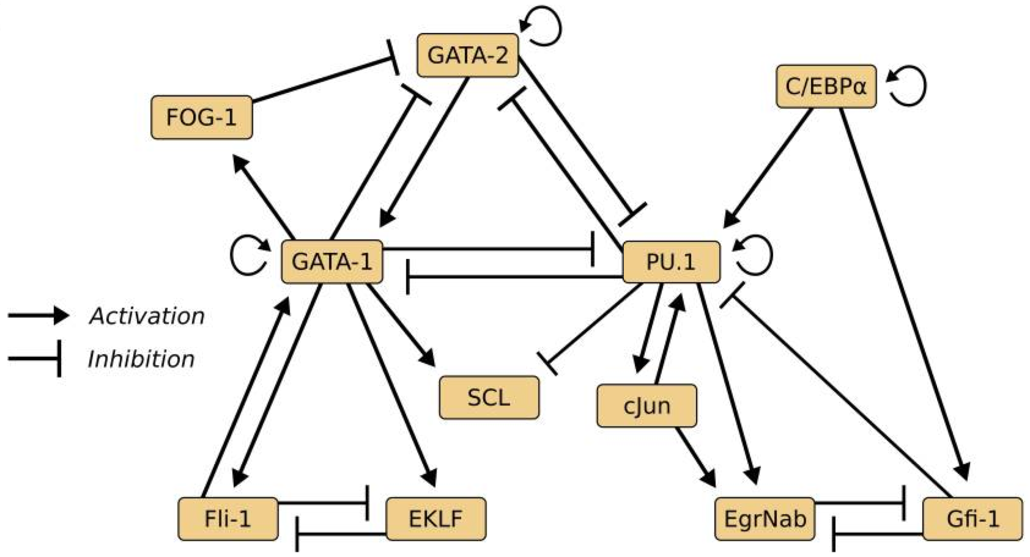
Gene regulatory networks
Krumsiek et al., PLOS One, 2011

Slide 4
Structure/Topology
Dynamics/Robustness
Size
In-degree/Out-degree
Network motifs
Feed forward loops
Feedback loops
Clusters of motifs
Update functions
Symmetry (redundancy)
Bias
Activation vs inhibition
Type
Random
Linear
Threshold
Canalizing
Attractors (phenotypes)
Number
Length
Basins of attraction
Stability
Sensitivity
Average sensitivity
Derrida values

Slide 5
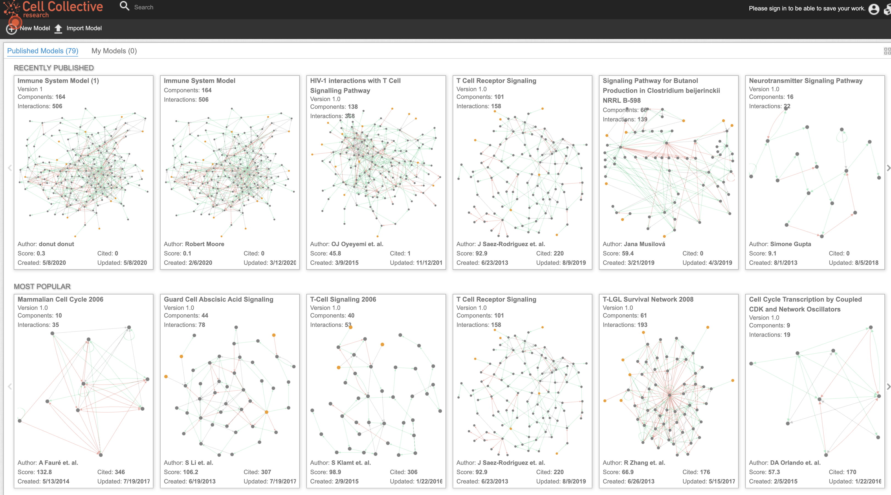
A meta-analysis of published Boolean GRN models
Joint work with first-year Iowa State honor students Haris Serdarevic, Jack Kinseth, Taras Butrie, Evan Hilton
Helikar et al., www.cellcollective.org

Slide 6
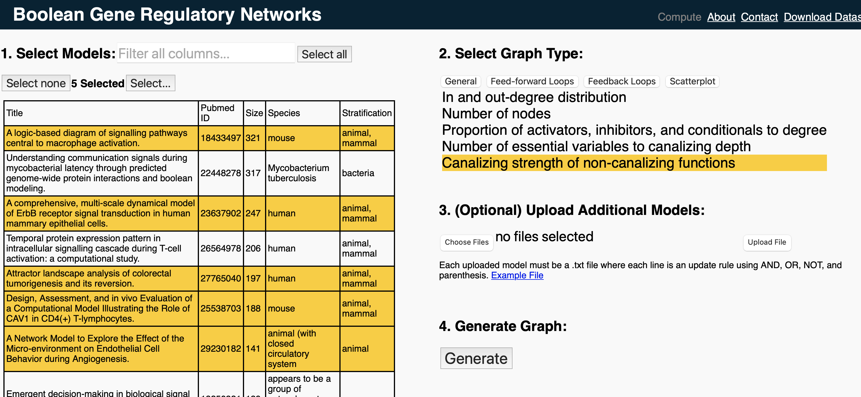
A meta-analysis of published Boolean GRN models
https://booleangenenetworks.math.iastate.edu
Kadelka et al. ArXiv, 2020

Slide 7
Outline
Introduction: Boolean gene regulatory network models
Features of the wiring diagram
Features of the update rules
Features of the dynamics
Modularity of biological networks

Slide 8
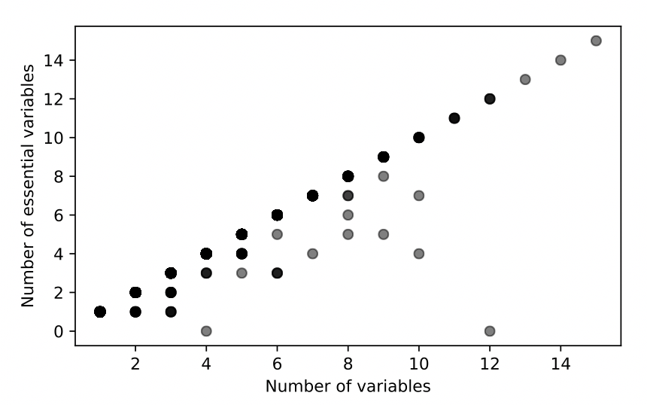
Some “interesting” findings
﻿PTEN = ( EGR1 & FRK & INPP5D & RRM1 & ! TGFBR3 & BMI1 & ! AEBP1 & ! BMI1 & ILK)|
(!ADM & !CSNK2A2 & EGR1 & FRK & INPP5D & RRM1 & TNF & ! TGFBR3 &
IFNGR2 & BMI1 & !AEBP1 & ! BMI1 & ILK)
Kadelka et al. Science Advances, 2024

Slide 9
Some “interesting” findings
128 / 6730 (1.9%) rules contain nonessential variables
﻿PTEN = ( EGR1 & FRK & INPP5D & RRM1 & ! TGFBR3 & BMI1 & ! AEBP1 & ! BMI1 & ILK)|
(!ADM & !CSNK2A2 & EGR1 & FRK & INPP5D & RRM1 & TNF & ! TGFBR3 &
IFNGR2 & BMI1 & !AEBP1 & ! BMI1 & ILK) = 0
Kadelka et al. Science Advances, 2024

Slide 10
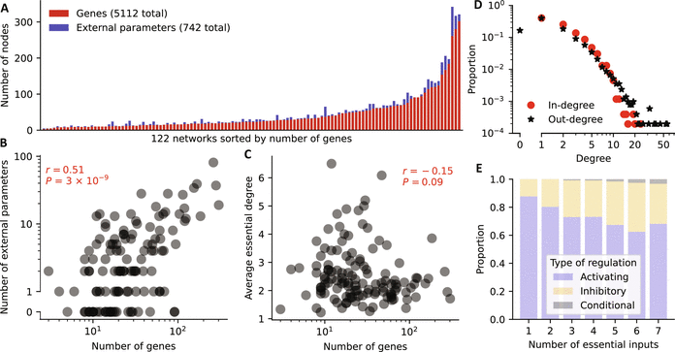
Basic results
As expected, larger networks have on average also more external parameters
Network size and degree are not correlated
mean degree = 2.56, median degree = 2.27
In-degree is Poisson-distributed, out-degree has a power-law tail,
More activators than inhibitors, particularly for regulatory functions with few inputs
Very few conditional regulators

Slide 11
Network motifs
Coherent
Incoherent
Feed-forward loops
Feed-forward loops
Positive feedback loop
Gene A
Gene A
Gene A
Gene B
Gene B
Gene B
Gene C
Gene C
Negative feedback loop
Gene A
Gene A
Gene A
Gene B
Gene B
Gene B
Gene C
Gene C
Gene C

Slide 12
Number of FFLs
Kadelka et al. Science Advances, 2024

Slide 13
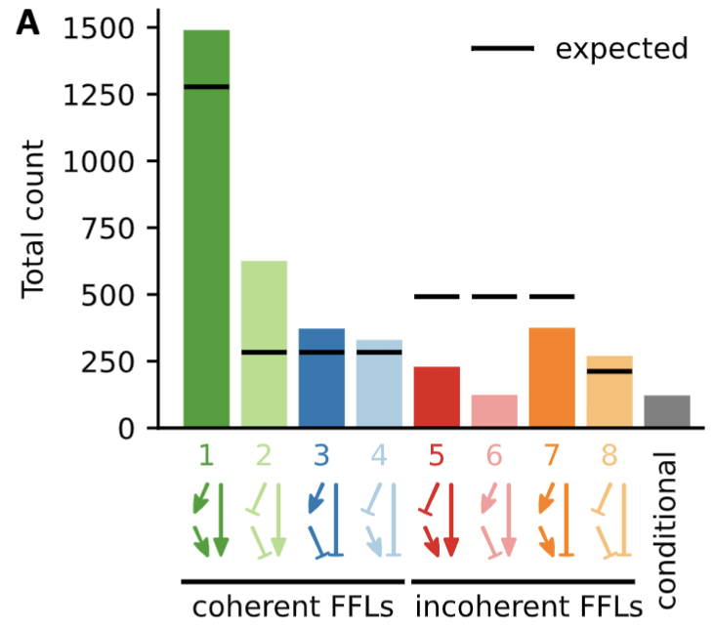
Number of FFLs
Yeast
E. coli
Kadelka et al. Science Advances, 2024 Alon et al. PNAS, 2003

Slide 14
Number of FFLs
Kadelka et al. Science Advances, 2024

Slide 15
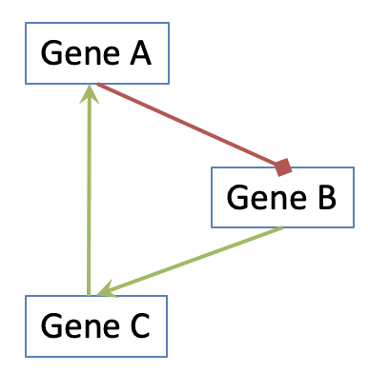
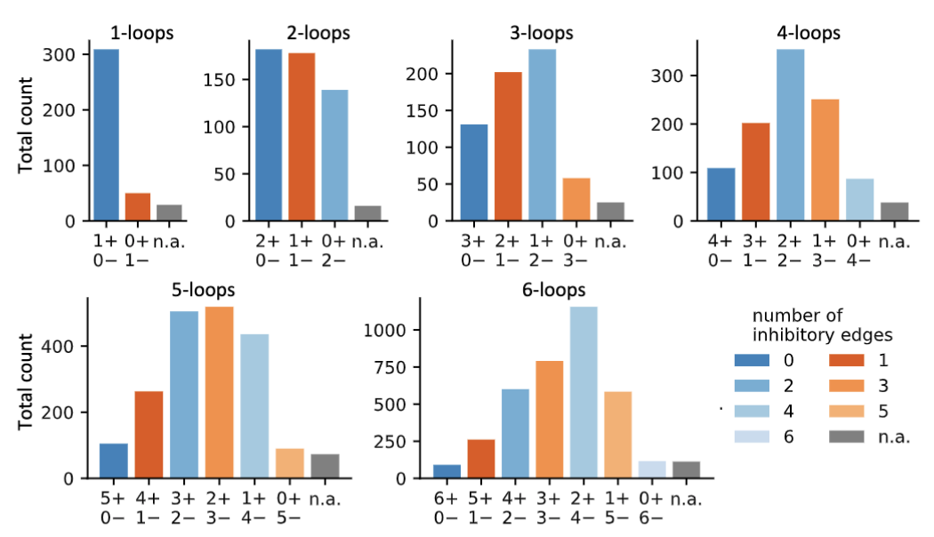
Number of feedback loops
Kadelka et al. Science Advances, 2024

Slide 16
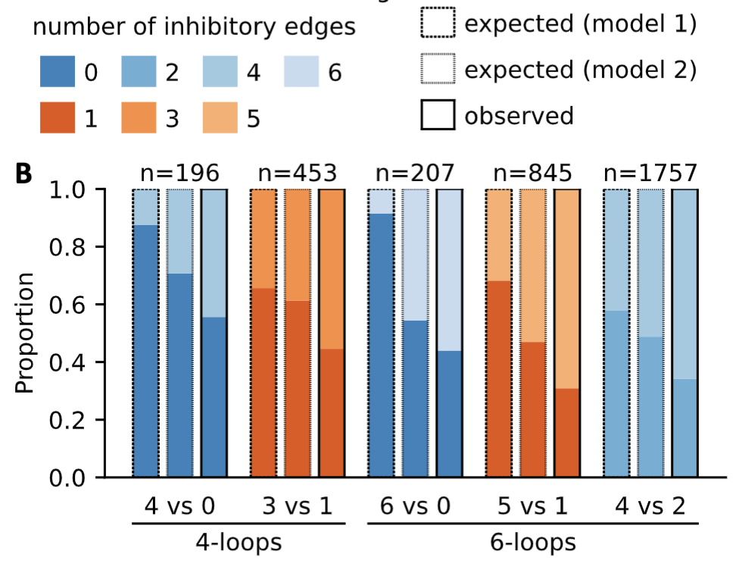
Number of feedback loops
Ongoing research question:
There are more activating than inhibitory interactions but we observe
more inhibitory interactions in complex loops - why?
Kadelka et al. Science Advances, 2024

Slide 17
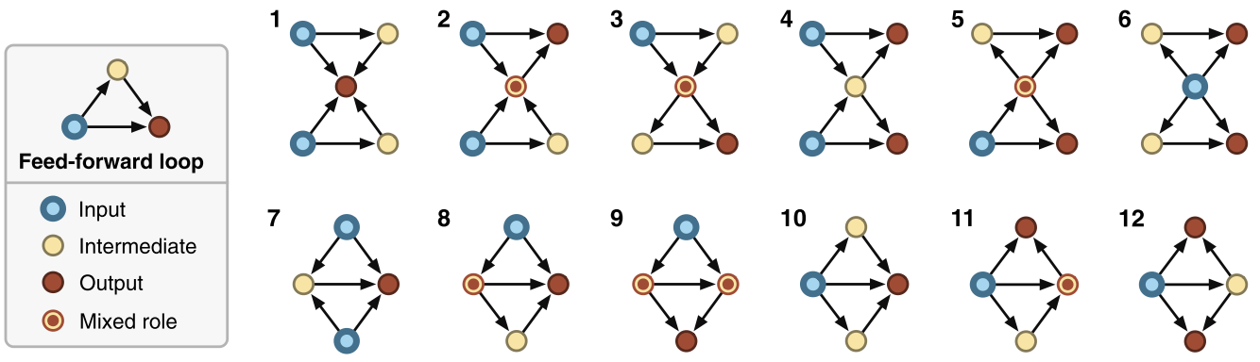
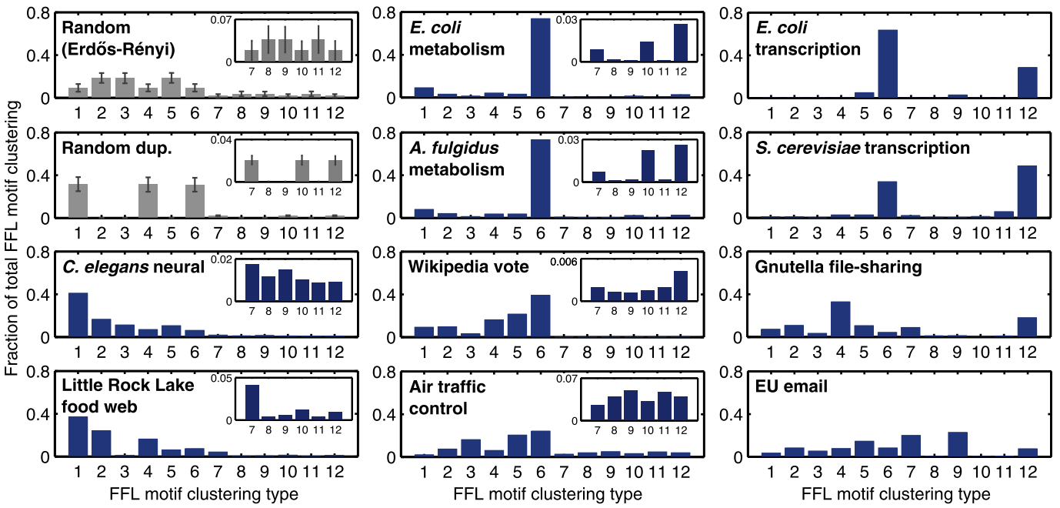
Number of FFL clusters
Gorochowski et al., Science Advances, 2018

Slide 18
Number of FFL clusters
Number of FFL clusters
Gorochowski et al., Science Advances, 2018

Slide 19
Outline
Introduction: Boolean gene regulatory network models
Features of the wiring diagram
Features of the update rules
Features of the dynamics
Modularity of biological networks

Slide 20
Canalization
Developmental reactions, as they occur in organisms submitted to natural selection are in general canalized. […] They are adjusted so as to bring about one definite end-result regardless of minor variations in conditions during the course of the reaction.
Waddington, Nature, 1942
Development is robust to changes in genotype and environment. It has been claimed that this robustness, termed canalization, evolves because of long-term natural selection for optimal phenotypes.
Canalization is the suppression of phenotypic variation. Depending on the causes of phenotypic variation, one speaks either of genetic or environmental canalization.
Siegal and Bergman, PNAS, 2002
Wagner et al., Evolution, 2017
Why some traits are phenotypically invariant despite apparent genetic and environmental changes has remained a major puzzle. […] Waddington coined the concept and term “canalization” to describe the robustness of phenotypes to perturbation.
Flatt, Quarterly Review of Biology, 2005
Canalization is an elusive concept. The notion that biological systems ought to evolve to a state of higher stability against mutational and environmental perturbations seems simple enough, but has been exceedingly difficult to prove.
Gibson and Wagner, BioEssays, 2000

Slide 21
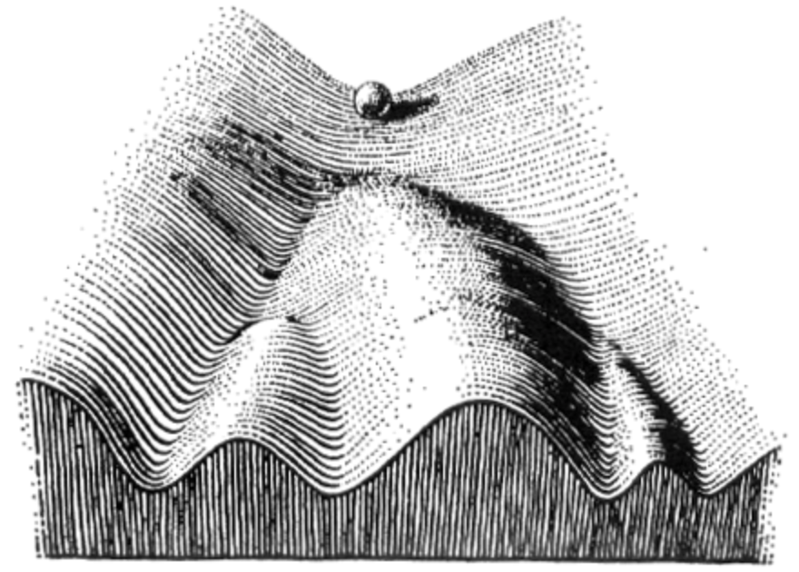
Canalization in embryonal development
Fitness landscape
Notes:
This led Waddington to develop the well-known concept of epigenetic landscape [2], [3], where cellular phenotypes are seen, metaphorically, as marbles rolling down a sloped and ridged landscape as the result of interactions amongst genes and epigenetic factors. The marbles ultimately settle in one of the valleys, each corresponding to a stable configuration that can be reached via the dynamics of the interaction network. In this view, genetic and epigenetic perturbations can only have a significant developmental effect if they force the natural path of the marbles over the ridges of the epigenetic landscape, thus making them settle in a different valley or stable configuration. [Marquez-Pita and Rocha, PLOS One, 2013]

Slide 22
Mathematical definitions of canalization
For a given Boolean gene regulatory network model, we can define canalization
on the level of variables
Canalizing variables (Kauffman, 1969 & 1974)
Nested canalizing variables (Kauffman, 2003)
Canalizing layer structure (Li et al., 2013; He and Macauley, 2016)
on the function level
Partially canalizing functions & collective canalization (Reichhardt and Bassler, 2007)
Canalization = input redundancy and input symmetry (Marquez-Pita & Rocha, 2013)
Canalizing strength (Kadelka, Keilty, Laubenbacher, 2020)

Slide 23
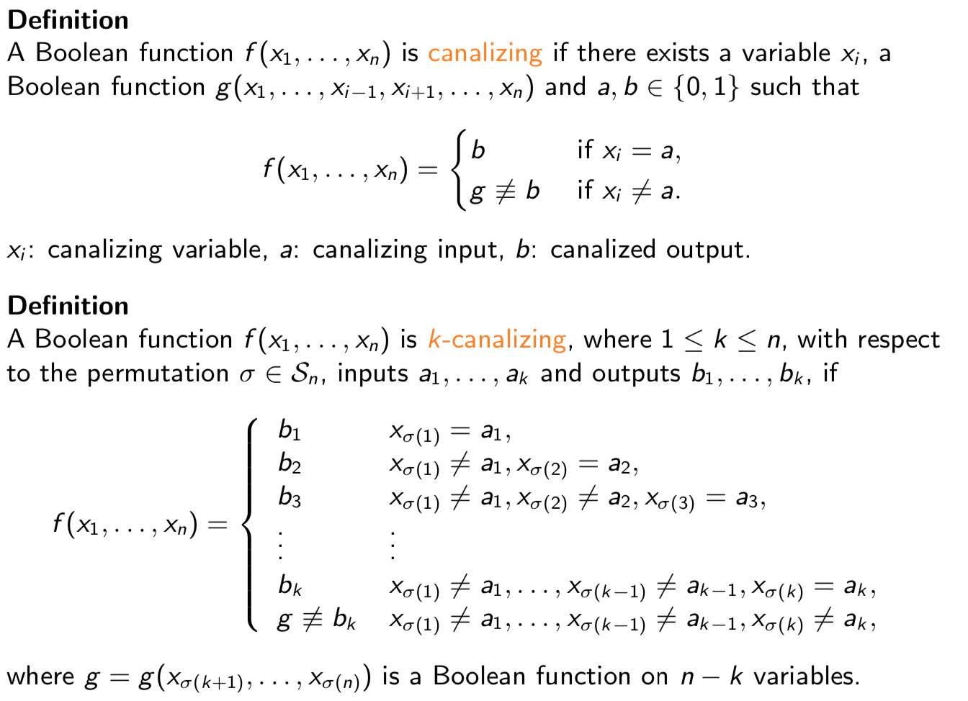
Canalizing functions
x_{i}
a
1-a
b
g(x₁,…,x_{n})
x_{σ(1)}
a₁
1-a₁
b₁
x_{σ(2)}
a₂
1-a₂
b₂
g(x₁,…,x_{n})
Kauffman et al. J Theoretical Biology, 1974
He and Macauley. Physica D, 2016

Slide 24
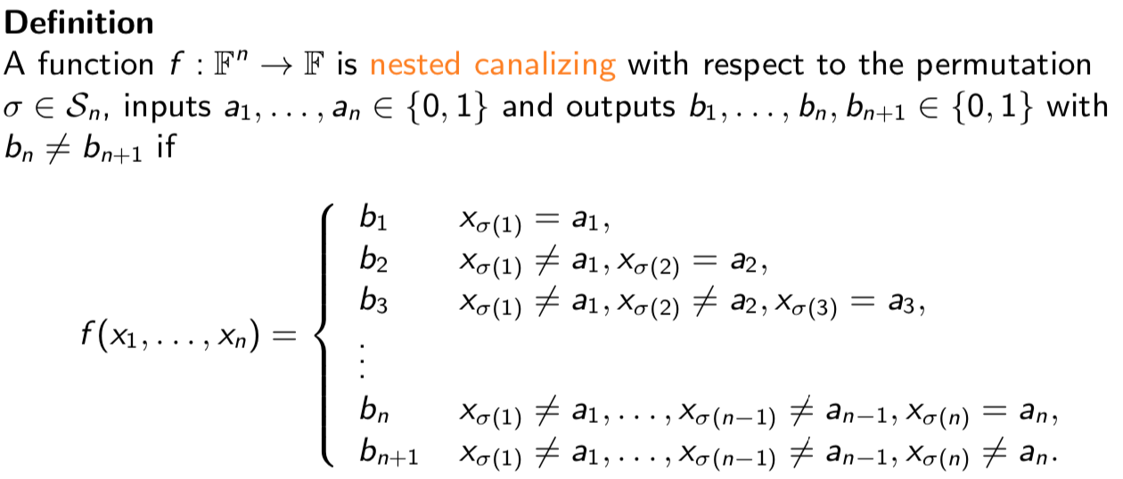
Nested canalizing functions (NCFs)
1st layer
f(x₁,x₂,x₃) = x₁ OR (x₂ AND x₃)
x₁
x₁
1
0
1
0
1
1
2nd layer
x₂
x₃
0
1
0
1
NCFs = Unate cascade functions =
Boolean Functions with shortest
average decision diagram
0
0
x₃
x₂
0
1
1
0
Jarrah et al. Physica D, 2007
0
1
1
0
Kauffman et al. PNAS, 2003

Slide 25
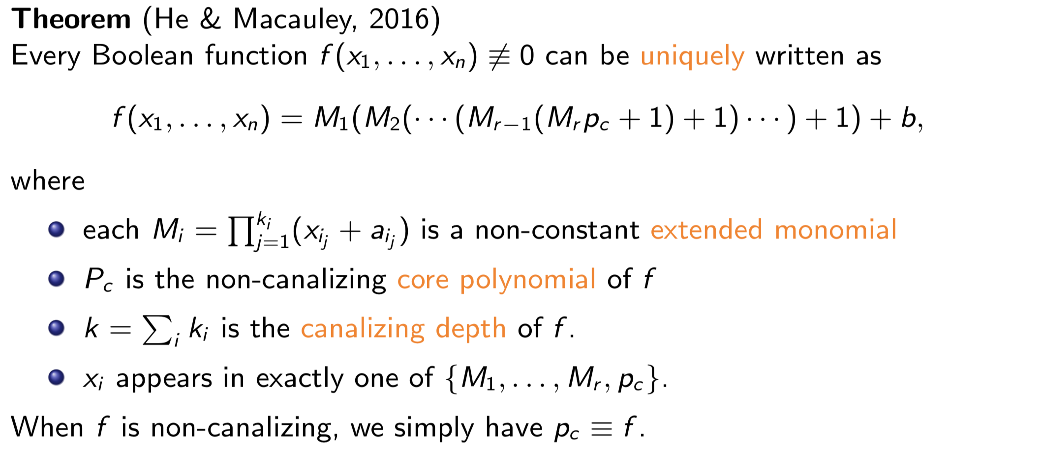
Stratification of all Boolean functions
He and Macauley. Physica D, 2016

Slide 26
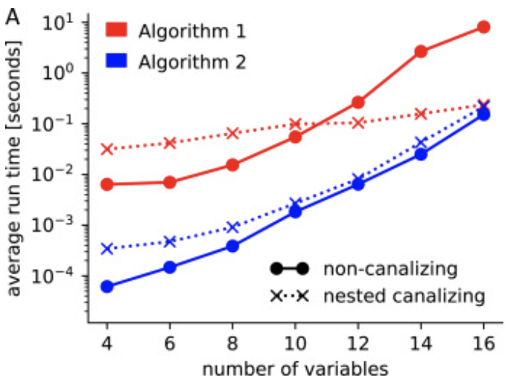
Determining canalizing layers is NP-hard
Theorem Unless P=NP, there is no polynomial time algorithm for determining the standard extended monomial form (i.e., the layers and the core polynomial) of a Boolean function.
Two algorithms:
Algorithm 1 (Macaulay2): exhaustive enumeration
Algorithm 2 (Python): linear algebra
Dimitrova, Stigler, Kadelka, Murrugarra. Automatica, 2022

Slide 27
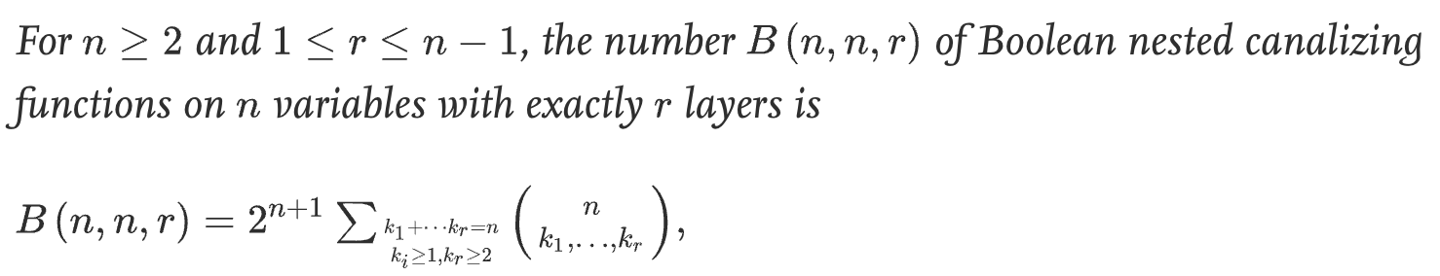
Prevalence of canalization
Dimitrova, Stigler, Kadelka, Murrugarra. Automatica, 2022

Slide 28
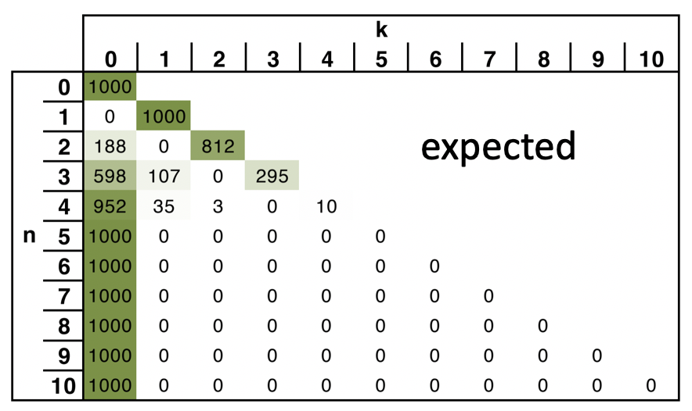
Prevalence of canalization
observed
Kadelka et al. Science Advances, 2024

Slide 29
Prevalence of canalization
observed
Nested canalizing functions are overrepresented in GRNs.
Kadelka et al. Science Advances, 2024

Slide 30
Prevalence of canalization
observed
Nested canalizing functions are overrepresented in GRNs. Question 1: Are GRNs enriched for canalizing functions in general or only NCFs?
Kadelka et al. Science Advances, 2024

Slide 31
Mathematical definitions of canalization
For a given Boolean gene regulatory network model, we can define canalization
on the level of variables
Canalizing variables (Kauffman, 1969 & 1974)
Nested canalizing variables (Kauffman, 2003)
Canalizing layer structure (Li et al., 2013; He and Macauley, 2016)
on the function level
Partially canalizing functions & collective canalization (Reichhardt and Bassler, 2007)
Canalization = input redundancy and input symmetry (Marquez-Pita & Rocha, 2013)
Canalizing strength (Kadelka, Keilty, Laubenbacher, 2023)

Slide 32
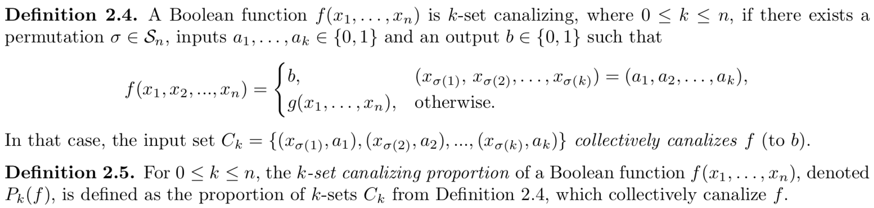
Collective canalization
1
1
0
0,1,1
1
1,1,1
0,0,1
1,0,1
0
1
0
0,1,0
1
1,1,0
0,0,0
1,0,0
x₃
x₂
f(x₁,x₂,x₃) = x₁ OR (x₂ AND x₃)
x₁

Slide 33
Collective canalization
1
1
0
0,1,1
1
1,1,1
x₁ = 1 → f = 1 → f is 1-set canalizing
x₂ = 1 → f = 0 or 1
x₃ = 1 → f = 0 or 1
x₁ = 0 → f = 0 or 1
x₂ = 0 → f = 0 or 1
x₃ = 0 → f = 0 or 1
→ P₁(f) = 1/6
0,0,1
1,0,1
0
1
0
0,1,0
1
1,1,0
0,0,0
1,0,0
x₃
x₂
f(x₁,x₂,x₃) = x₁ OR (x₂ AND x₃)
x₁

Slide 34
Collective canalization
1
1
0
0,1,1
1
1,1,1
P₁(f) = 1/6 (= proportion of “constant” faces)
P₂(f) = 7/12 (= proportion of “constant” edges)
P₃(f) = 1 (= proportion of “constant” vertices)
In general,
P_{k}(f) = proportion of (n-k)-dimensional “faces” that are “constant” or “monochromatic”
0,0,1
1,0,1
0
1
0
0,1,0
1
1,1,0
0,0,0
1,0,0
x₃
x₂
f(x₁,x₂,x₃) = x₁ OR (x₂ AND x₃)
x₁

Slide 35
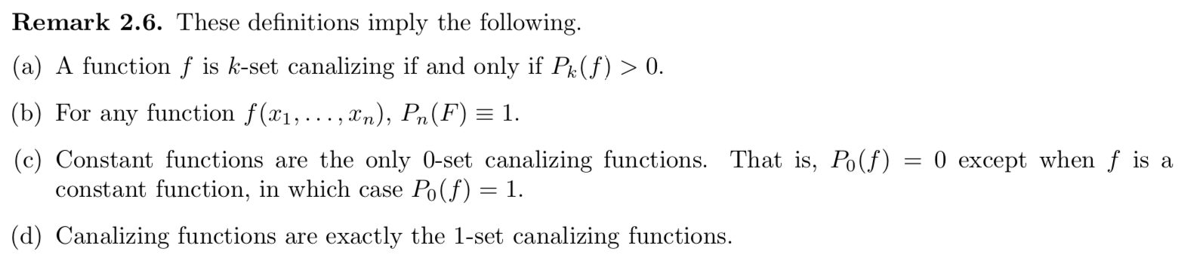
Collective canalization
1
1
0
0,1,1
1
1,1,1
P₁(f) = 1/6 (= proportion of “constant” faces)
P₂(f) = 7/12 (= proportion of “constant” edges)
P₃(f) = 1 (= proportion of “constant” vertices)
In general,
P_{k}(f) = proportion of (n-k)-dimensional “faces” that are “constant” or “monochromatic”
0,0,1
1,0,1
0
1
0
0,1,0
1
1,1,0
0,0,0
1,0,0
x₃
x₂
f(x₁,x₂,x₃) = x₁ OR (x₂ AND x₃)
x₁

Slide 36
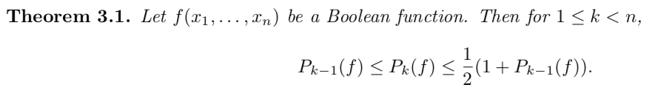
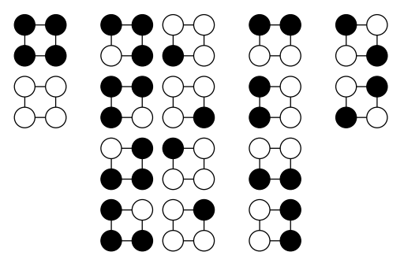
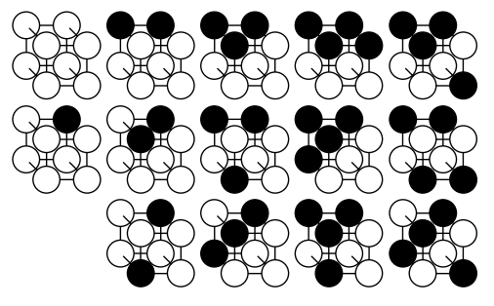
Towards a new measure of canalization
Question 2a: How can we find better bounds?
Question 2b: What are good bounds for P_{n-1}(f) given P_{k}(f)?
4 classes of Boolean functions for n=2
One member of each class for n=3
Reichhardt and Bassler, Journal of Physics A, 2007
Reichhardt and Bassler, Journal of Physics A, 2007
Question 3: How can we find a member of each equivalence class for a general n?

Slide 37
Towards a new measure of canalization
Kadelka, Keilty, Laubenbacher. Adv Appl Math, 2023

Slide 38
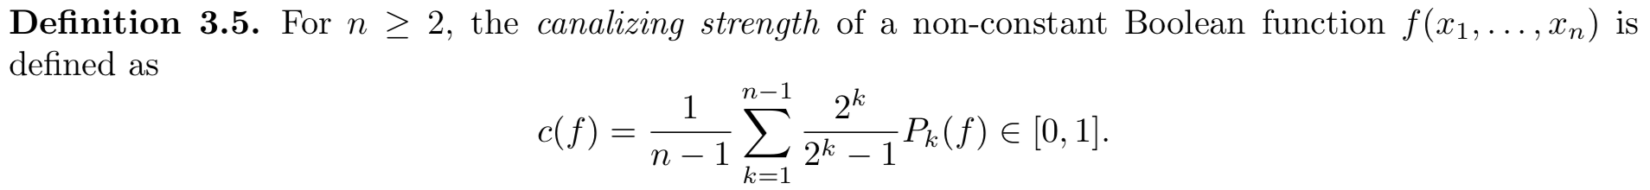
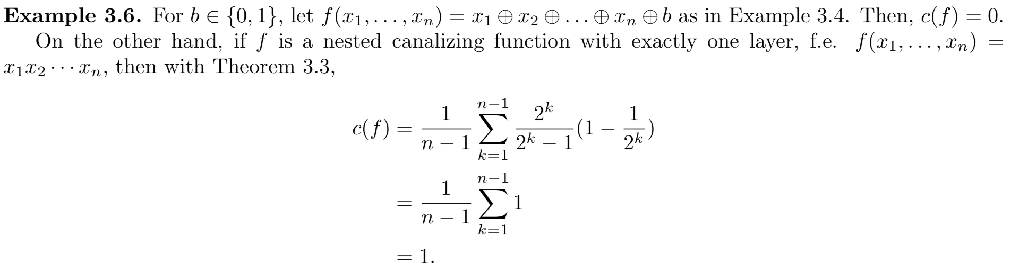
Towards a new measure of canalization
Kadelka, Keilty, Laubenbacher. Adv Appl Math, 2023

Slide 39
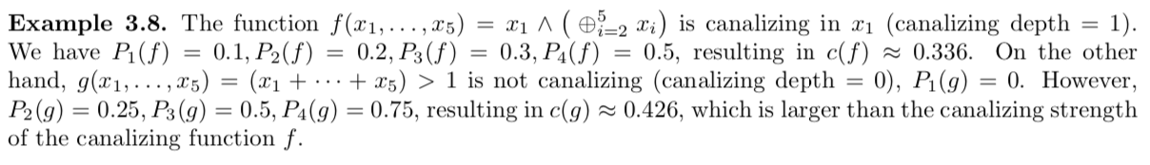
Canalizing strength
Kadelka, Keilty, Laubenbacher. Adv Appl Math, 2023

Slide 40
Canalizing strength of published non-canalizing rules
observed
Kadelka et al. Science Advances, 2024

Slide 41
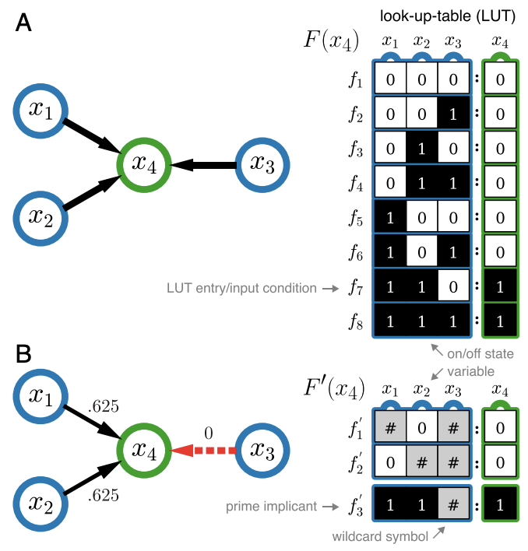
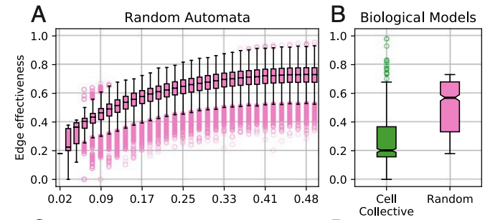
Logical redundancy: an alternative measure of collective canalization
Marquez-Pita and Rocha, PLOS One, 2013; Gates, Correia, Wang, Rocha, PNAS, 2021
Question 4: Canalizing strength and input redundancy both aim to capture collective canalization. How are they different?
Question 5: Which definition is biologically more relevant / accurate?
Gates, Correia, Wang, Rocha, PNAS, 2021
all 4-input Boolean functions
Gates, Correia, Wang, Rocha, PNAS, 2021

Slide 42
Logical redundancy: an alternative measure of collective canalization

Slide 43
Logical redundancy: an alternative measure of collective canalization

Slide 44
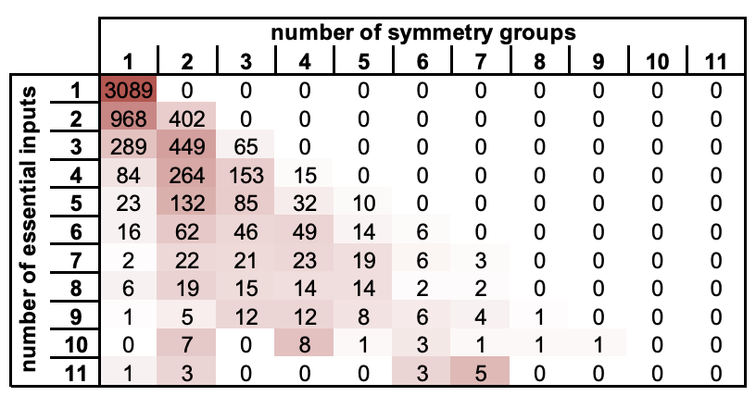
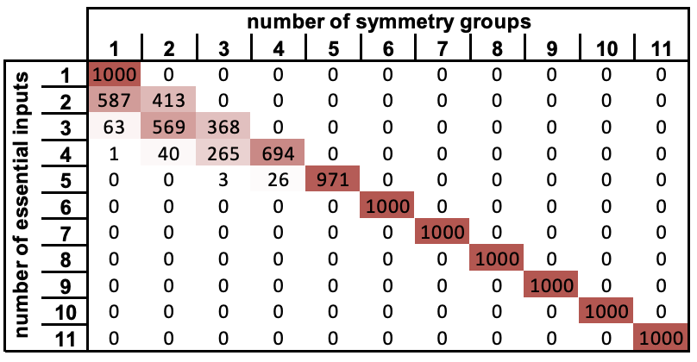
Published GRN models differ from random models in other ways
More symmetry / redundancy among inputs
observed
random expectation
Kadelka et al. Science Advances, 2024

Slide 45
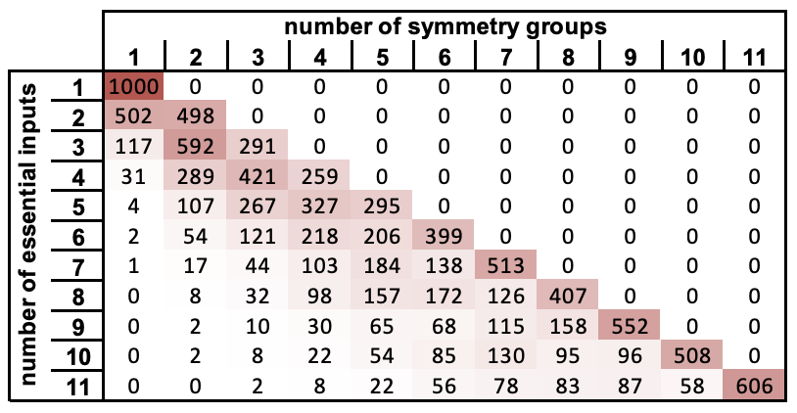
Published GRN models differ from random models in other ways
More symmetry / redundancy among inputs
observed
random expectation, canalizing depth matched
Kadelka et al. Science Advances, 2024

Slide 46
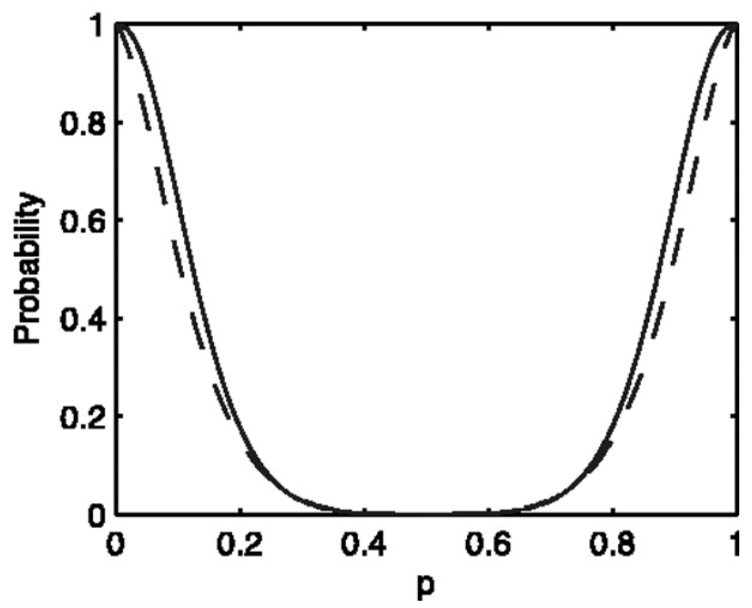
Published GRN models differ from random models in other ways
More symmetry / redundancy among inputs
Published rules exhibit bias
BUT:
Probability that random function is canalizing
bias p
Adapted from Shmulevich et al., PNAS, 2003

Slide 47
Published GRN models differ from random models in other ways
More symmetry / redundancy among inputs
Published rules exhibit bias
Published rules contain more 0s than 1s

Slide 48
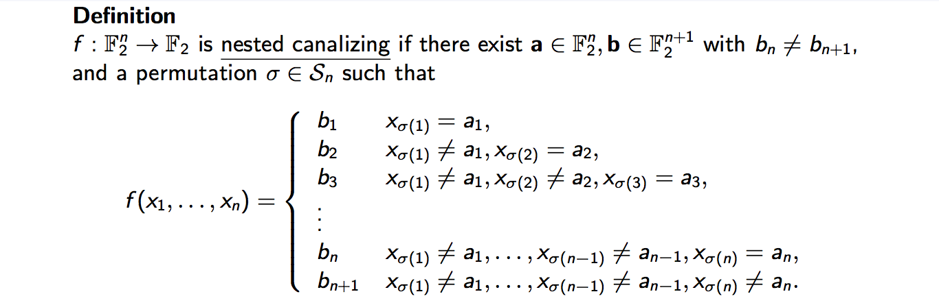
Canalizing inputs and outputs
x₁
a₁
1-a₁
Sub-analysis of all NCFs with 4 variables
b₁
x₂
a₂
a1 | a2 | a3 | count
1 | 1 | 1 | 128
1 | 1 | 0 | 54
0 | 0 | 0 | 30
1 | 0 | 1 | 25
1 | 0 | 0 | 17
0 | 0 | 1 | 14
0 | 1 | 1 | 12
0 | 1 | 0 | 4
b1 | b2 | b3 | count
0 | 0 | 0 | 85
0 | 0 | 1 | 68
0 | 1 | 1 | 42
1 | 1 | 1 | 30
1 | 1 | 0 | 21
0 | 1 | 0 | 18
1 | 0 | 1 | 11
1 | 0 | 0 | 9
1-a₂
b₂
x₃
a₃
1-a₃
b₃
x₄
a₄
1-a₄
b₄
1-b₄

Slide 49
Canalizing inputs and outputs
all NCFs with 3 variables
a1 | a2 | count
1 | 1 | 252
1 | 0 | 108
0 | 0 | 60
0 | 1 | 55
b1 | b2 | count
0 | 0 | 185
0 | 1 | 143
1 | 1 | 89
1 | 0 | 58
all NCFs with 5 variables
a1 | a2 | a3 | a4 | count
1 | 1 | 1 | 1 | 69
1 | 1 | 1 | 0 | 22
1 | 0 | 0 | 0 | 18
1 | 1 | 0 | 0 | 12
0 | 0 | 0 | 1 | 7
0 | 1 | 1 | 1 | 5
1 | 0 | 0 | 1 | 5
0 | 0 | 1 | 1 | 3
1 | 1 | 0 | 1 | 3
1 | 0 | 1 | 1 | 3
0 | 0 | 0 | 0 | 2
0 | 1 | 1 | 0 | 1
b1 | b2 | b3 | b4 | count
0 | 0 | 0 | 0 | 37
0 | 0 | 0 | 1 | 28
0 | 0 | 1 | 1 | 18
1 | 1 | 1 | 1 | 17
0 | 1 | 1 | 1 | 16
1 | 0 | 0 | 0 | 8
0 | 0 | 1 | 0 | 5
1 | 1 | 1 | 0 | 4
0 | 1 | 1 | 0 | 3
1 | 0 | 0 | 1 | 3
0 | 1 | 0 | 1 | 3
1 | 0 | 1 | 1 | 3
1 | 0 | 1 | 0 | 2
1 | 1 | 0 | 0 | 2
0 | 1 | 0 | 0 | 1
GRNs contain more activators (1) than inhibitors (0)
Genes are by default off (0)

Slide 50
Outline
Introduction: Boolean gene regulatory network models
Features of the wiring diagram
Features of the update rules
Features of the dynamics
Modularity of biological networks

Slide 51
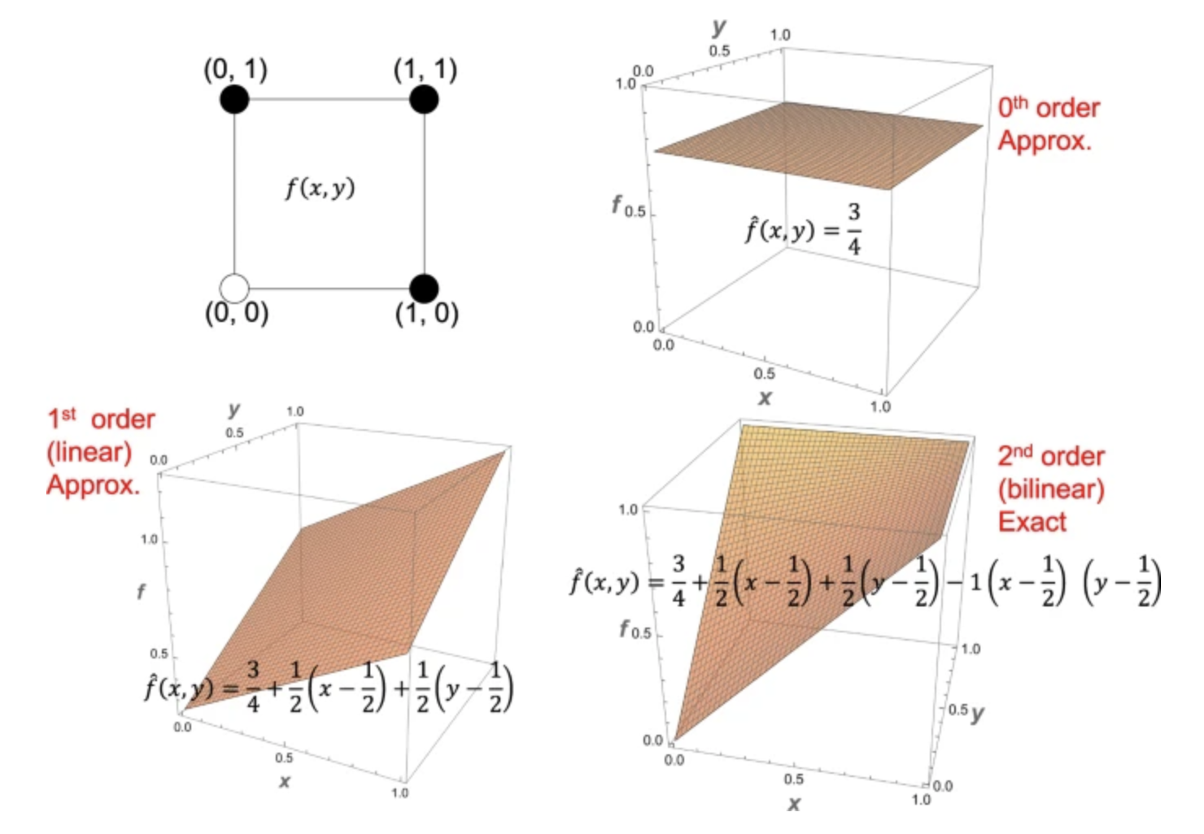
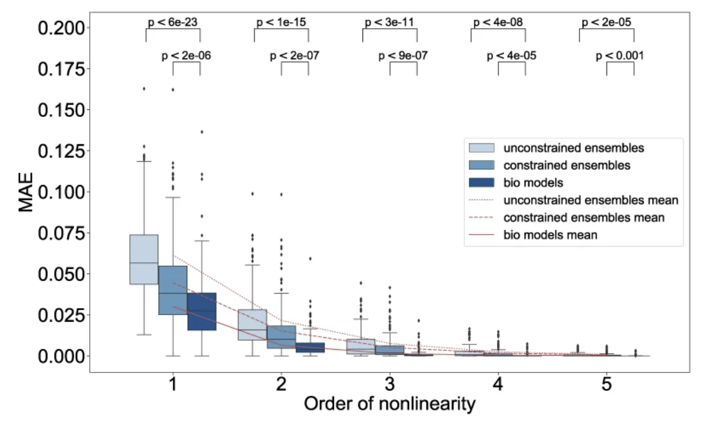
Published GRN models differ from random models in other ways
Biological regulatory rules exhibit more symmetry / redundancy among inputs
Biological regulatory rules are biased
Biological regulatory rules contain on average more 0s than 1s
Biological regulatory rules contain more activators than inhibitors
Biological networks exhibit more linear dynamics (Manicka et al., npj SBA, 2023)
Manicka et al., npj SBA, 2023

Slide 52
Published GRN models differ from random models in other ways
Biological regulatory rules exhibit more symmetry / redundancy among inputs
Biological regulatory rules are biased
Biological regulatory rules contain on average more 0s than 1s
Biological regulatory rules contain more activators than inhibitors
Biological networks exhibit more linear dynamics (Manicka et al., npj SBA, 2023)
…
Given all these observations, can we disentangle cause and effect? E.g., do biological network exhibit more linear dynamics (than random networks) only because they are more biased and canalizing?

Slide 53
Canalization explains the high approximability of biological networks
Manicka et al., npj SBA, 2023

Slide 54
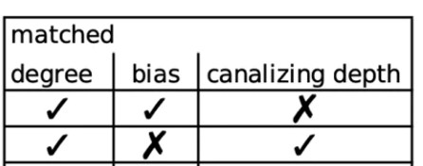


Canalization explains the high approximability of biological networks
Null model 0
Null model 1
Manicka et al., npj SBA, 2023

Slide 55
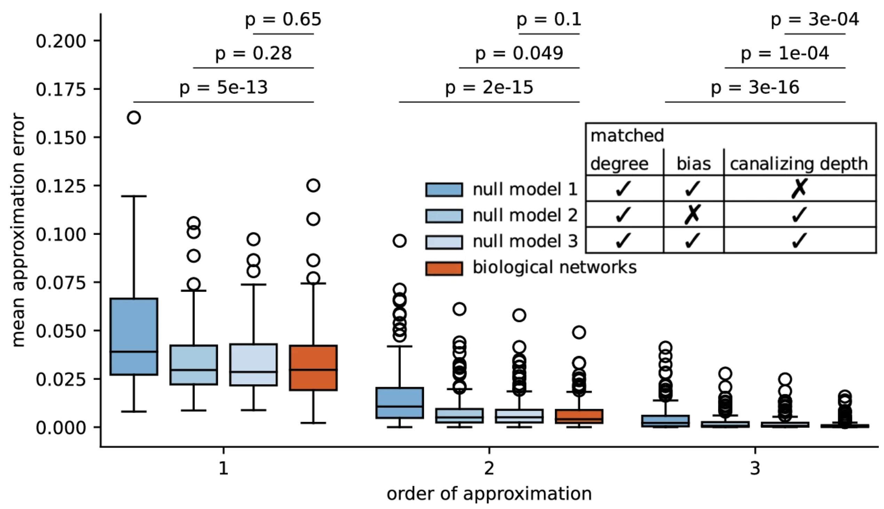
Canalization explains the high approximability of biological networks
Kadelka and Murrugarra, npj SBA, 2024

Slide 56
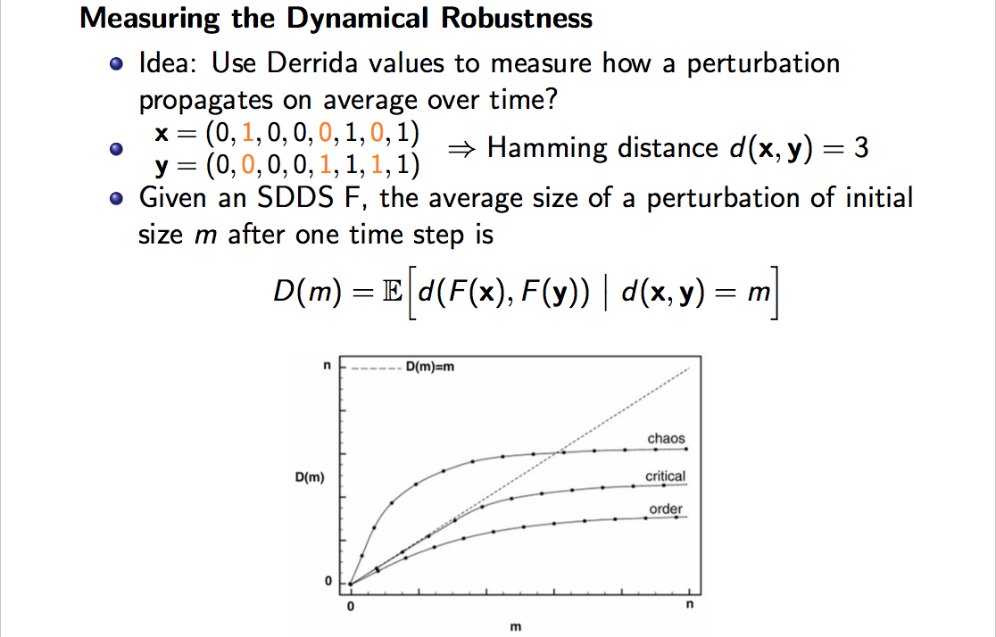
Criticality conjecture
Chaos: D(1) >> 1 Criticality: D(1) = 1 Order: D(1) << 1
Darabos et al., PLOS One, 2011

Slide 57
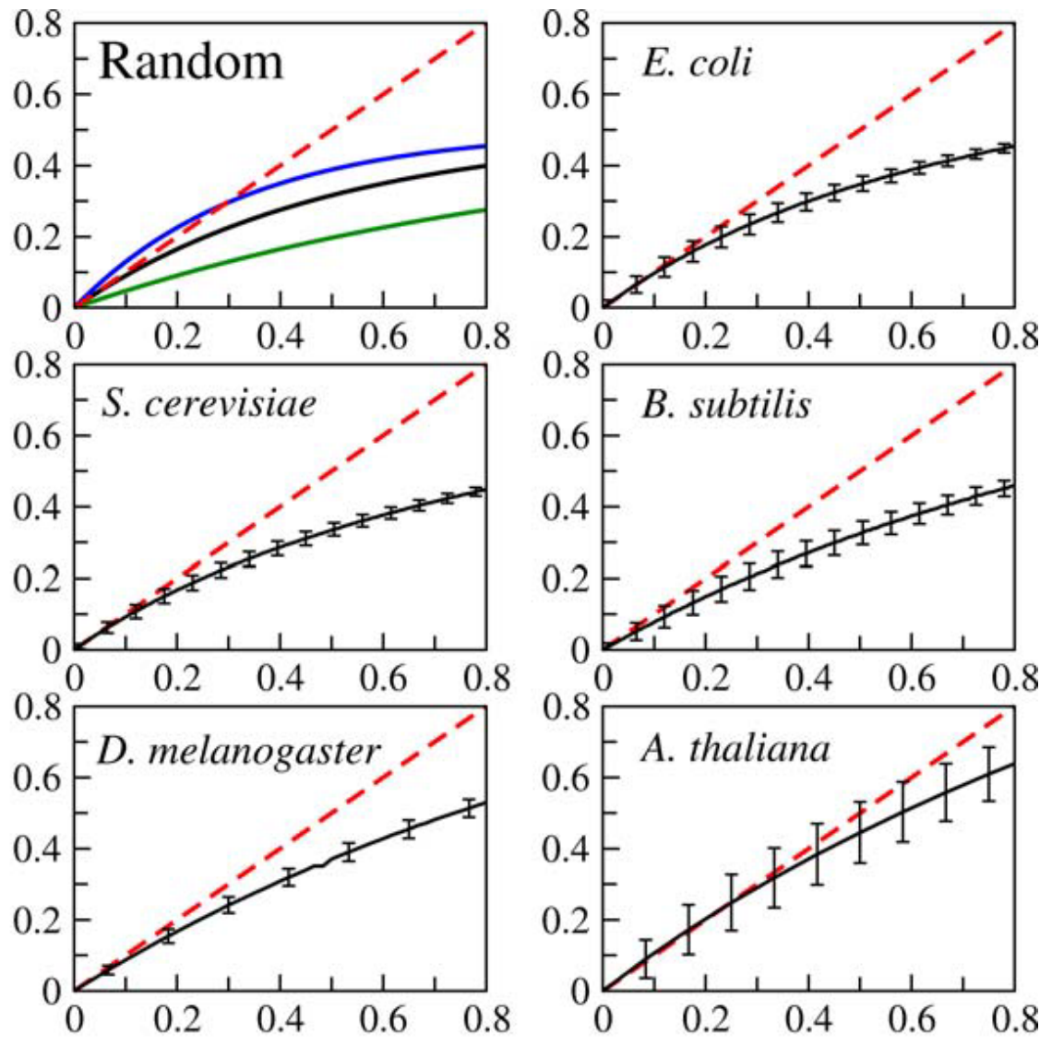
Criticality conjecture
Gene regulatory networks need to be
Robust enough to external variability
Adaptable enough to new environments (plasticity)
Balleza et al., PLOS One, 2008
Darabos et al., PLOS One, 2011

Slide 58
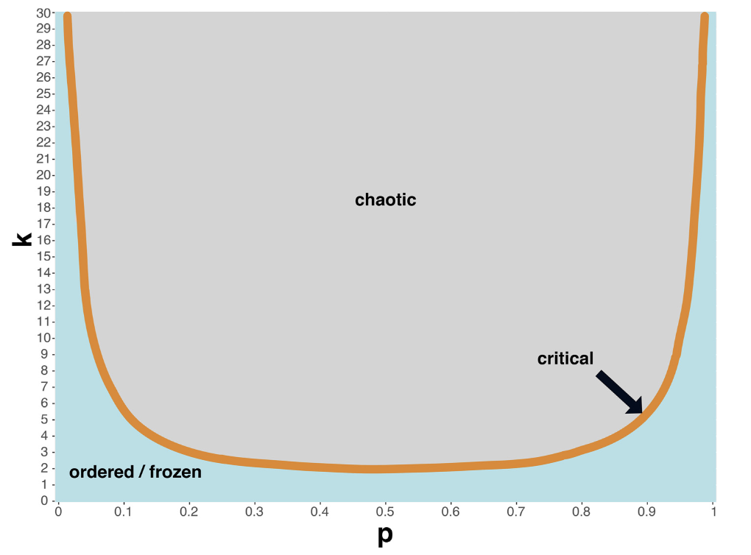
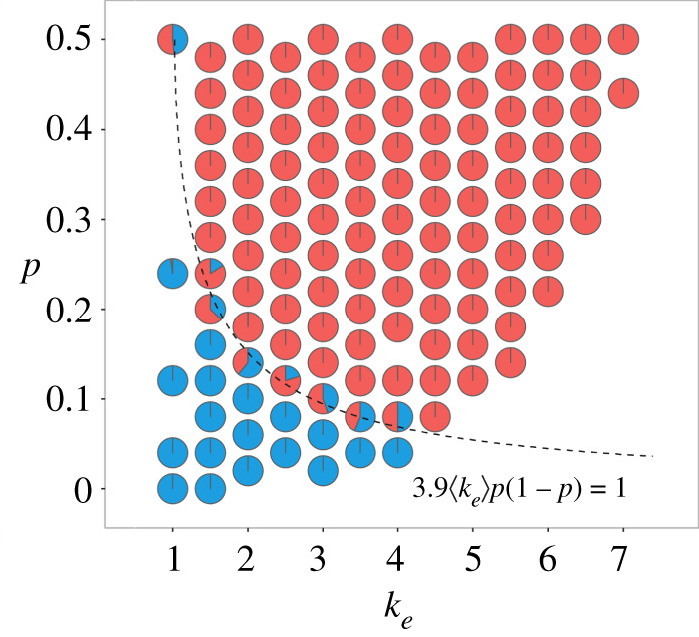
Canalization and bias determine the dynamical regime
Accounting for canalization yields a better threshold:
Critical threshold = 2kp(1-p) Shmulevich et al., Phys. Rev Letter, 2004
Kuehlwein et al., Comp & Struct Biotech Journal, 2020
Manicka et al., J Royal Society Interface, 2022

Slide 59
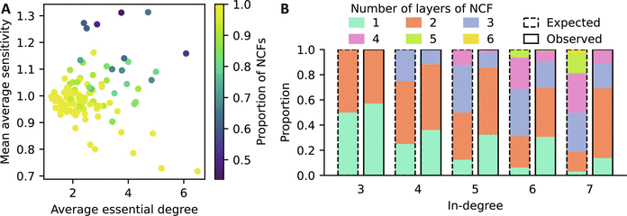
Abundance of insensitive NCFs buffers GRNs from chaotic dynamics
Irrespective of the degree, the average sensitivity of an NCF is 1.
Most biological networks exhibit critical or ordered dynamics
Kadelka et al., Physica D, 2017
Kadelka et al. Science Advances, 2024

Slide 60
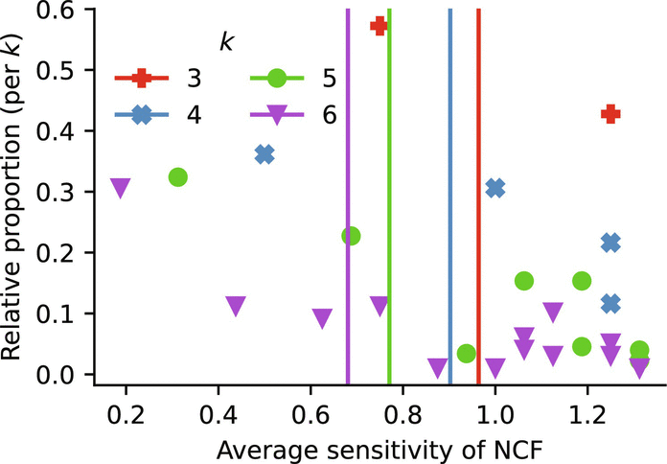
Abundance of insensitive NCFs buffers GRNs from chaotic dynamics
Kadelka et al. Science Advances, 2024

Slide 61


Collaborators
Elena Dimitrova (Cal Poly)
Brandilyn Stigler (Southern Methodist U)
David Murrugarra (U of Kentucky)
Matthew Wheeler (U of Florida)
Reinhard Laubenbacher (U of Florida)
Benjamin Keilty (U of Connecticut)
Jack Kuipers (ETH Zurich)
Taras Butrie (ISU)
Evan Hilton (ISU)
Jack Kinseth (ISU)
Haris Serdarevic (ISU)
Addison Schmidt (ISU)
Thank you!
Questions: ckadelka@iastate.edu

Slide 62
References
1. Dimitrova, E., Stigler, B., Kadelka, C., & Murrugarra, D. (2022). Revealing the canalizing structure of Boolean functions: Algorithms and applications. Automatica, 146, 110630.
2. Kadelka, C., Butrie, T. M., Hilton, E., Kinseth, J., Schmidt, A., & Serdarevic, H. (2024). A meta-analysis of Boolean network models reveals design principles of gene regulatory networks. Science Advances, 10(2), eadj0822.
3. Kadelka, C., Keilty, B., & Laubenbacher, R. (2023). Collectively canalizing Boolean functions. Advances in Applied Mathematics, 145, 102475.
4. Kadelka, C., & Murrugarra, D. (2024). Canalization reduces the nonlinearity of regulation in biological networks. npj Systems Biology and Applications, 10(1), 67.
5. Kadelka, C., Kuipers, J., & Laubenbacher, R. (2017). The influence of canalization on the robustness of Boolean networks. Physica D: Nonlinear Phenomena, 353, 39-47.
Thank you!
Questions: ckadelka@iastate.edu

